Slide 1
AS RIGID AS POSSIBLE INTERPOLATION
Group Number -19
Project -15
Chaitanya Garg(2021248)
Website : Github

Slide 2
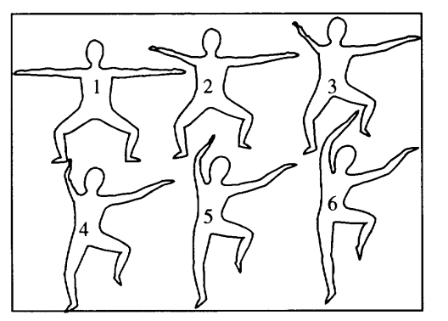
Motivation
As Rigid as Possible is a morphing technique and it is preferred over the other morphing algorithms due to the following reasons:
Natural appearance: ARAP aims to produce interpolations that avoid unnatural stretching and distortion of the shapes involved like rigid character motion.
Preservation of features: ARAP aims to preserve natural features as far as possible like angles, boundary, area during transition from source to target.
(Source : ACM)

Slide 3
Motivation
Computational Efficiency: ARAP is computationally a fast morphing algorithm, and hence finds application in interactive design for faster image processing and conversion, aviation industry for more aerodynamic and efficient designing.
Due to these reasons, it is necessary to know about this algorithm.

Slide 4

Literature Survey
1. As-Rigid-As-Possible Shape Interpolation by Marc Alexa , Daniel Cohen-Or ,
Paper introduces ARAP and highlights its advantages
The paper gives a glimpse of the delaunay triangulation and mapping involved
It rigorously focuses on the interpolation aspect of the ARAP algorithm and give the required equations and examples for understanding
It further goes to showcase some of the obvious limitations and gives solutions to those
Our Goal is to minimise the value of E(V(t))(ARAP energy)

Slide 5
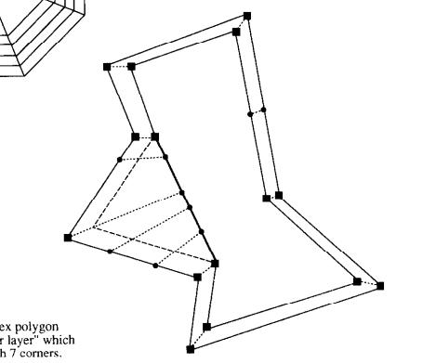
Literature Survey
2. On compatible triangulations of simple polygons by Boris Aronov, Raimund Seidel & Diane Souvaine
This paper covers the idea of triangulations along with their mapping
The idea given is quite simple, once the is done, create a boundary polynomial using the triangles from triangulation and then map to target boundary polynomial based on Euclidean distance.
Works well when the boundary triangle doesn’t have too many triangles in it
Limitation : Introduce more points in case polygon has different number of sides
Mapping

Slide 6

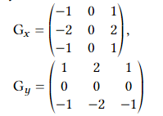
Point Extraction From Image
Setup OpenCV to read the image, so that basic filters like Guassian, Median can be applied and tested
For Point Extraction,
Apply Median Glur - > Grey Scale -> Sobel Filter(Basically a Convolution Along X and Y) -> Non Maximal Suppression -> Boundaryto 0 -> minPointDistance
Problems Faced
A bit in OpenCV as file path was not automatically correct, had to be handled manually
For the purpose of storing points I made classes but they had naming confliction so created Point2dim for points
GreyScaling Formula
Sobel Filter Convultion

Slide 7
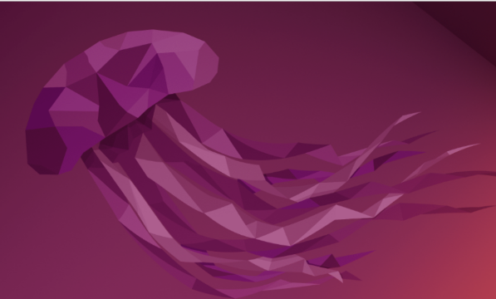
Point Extraction From Image-Original

Slide 8
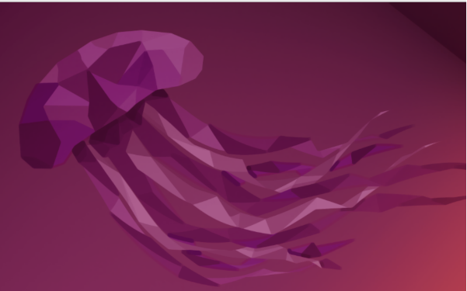
Point Extraction From Image-Median Blur
Original
Blur

Slide 9
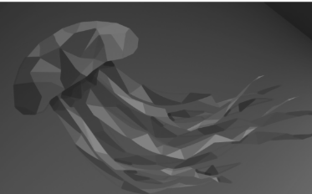
Point Extraction From Image-GreyScaling
Blur
GreyScale

Slide 10
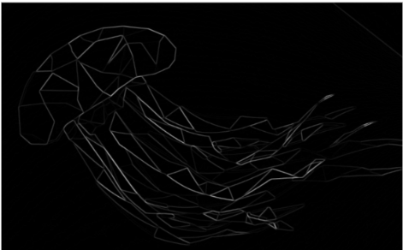
Point Extraction From Image-Sobel Filter
GreyScale
Sobel Filter

Slide 11
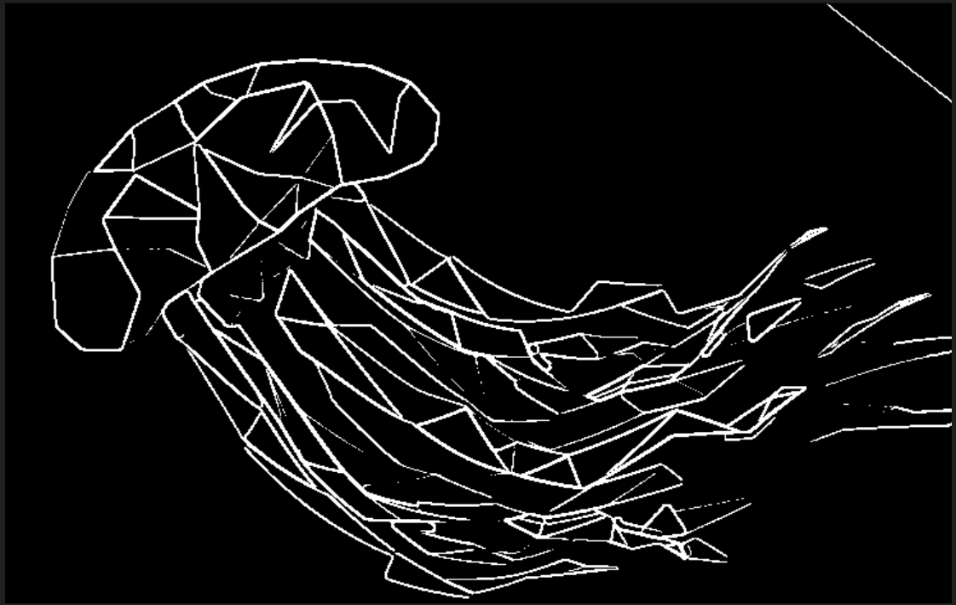
Point Extraction From Image-Threshold
Sobel Filter
Threshold

Slide 12
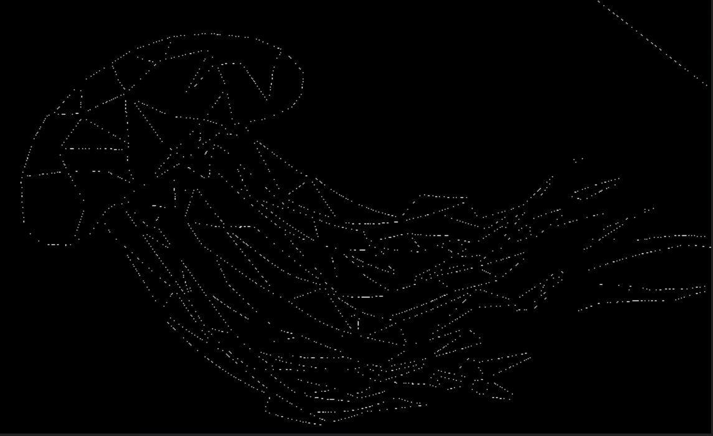
Point Extraction From Image-Non Max Sup
Sobel Filter
Non Max Sup

Slide 13
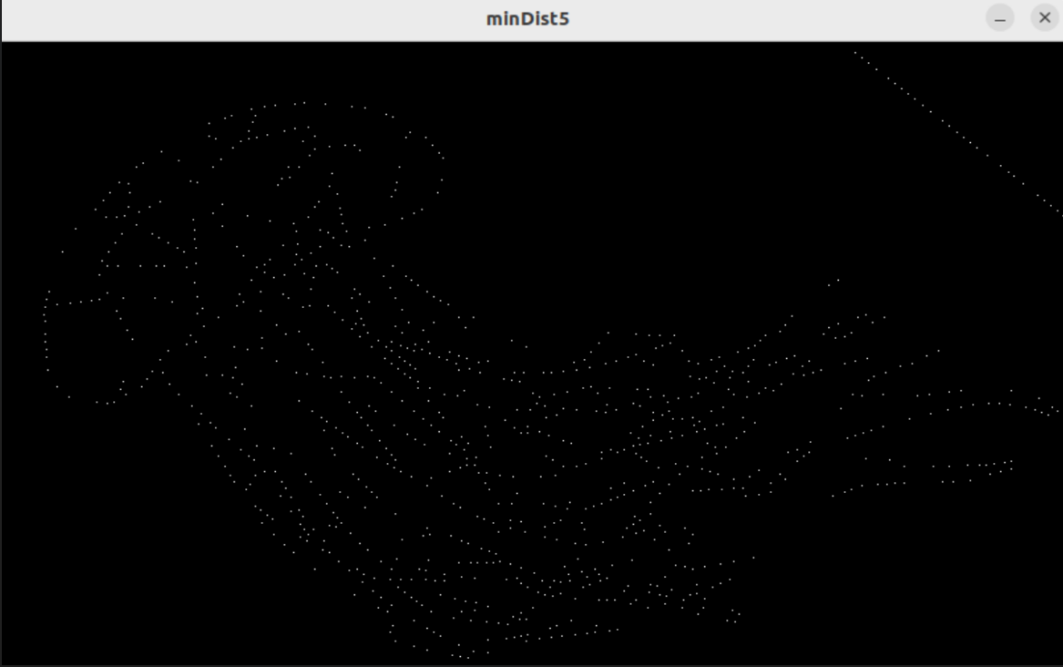
Point Extraction From Image-MaxDist
Non Max Sup
Min Dist

Slide 14
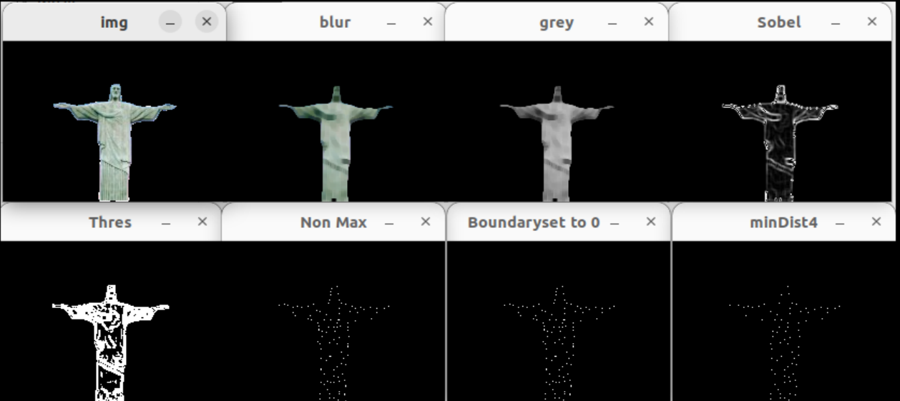
Another Example Rio De Janeiro

Slide 15
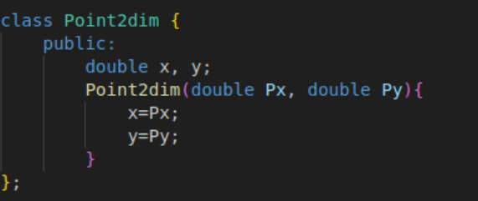
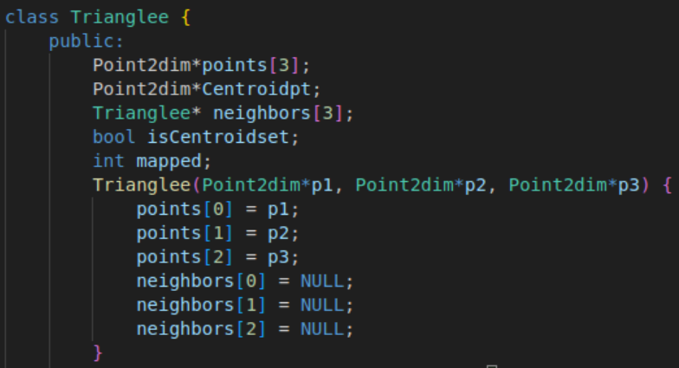
Point Extraction- Final Step
Iterate over the resultant image then, store the points with rgb as (255,255,255) in Point2dim array, return when iteration is over.

Slide 16
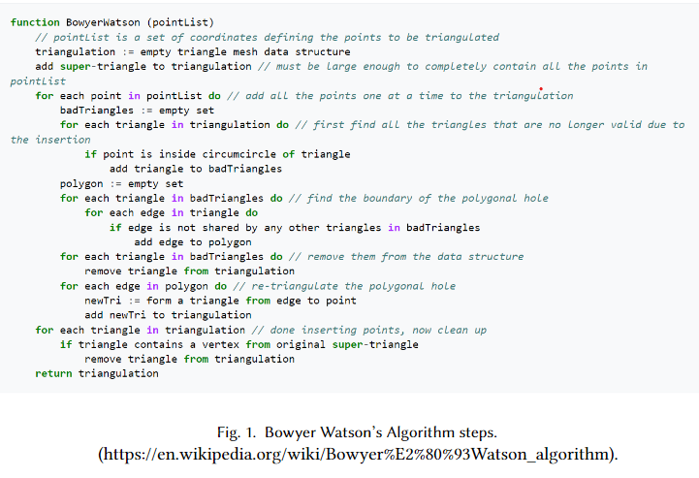
Delaunay Triangulation-Algorithm
Simplest Algorithm for triangulation of keeping rigid shape when transitioning hence preferred
Aim is to maximize the minimum angle of the triangle
The algo I have used is Bowser Watson Algorithm

Slide 17
Delaunay Triangulation-Problems Faced
The values formed when checking if a point lies in a circle or not were giving an overflow hence, segmentation fault was being obtained .
As a resolution, all x,y coords of the points were divided by 100 to make sure that algorithm functions smoothly
The algorithm failed to realise same triangles due to the use of a vector. This created 1000’s of same triangles which increased the algo time.
As a resolution, all the triangles were now stored in a set instead of an array.Backlash, if we see iterative triangle additions might differ, output is constant

Slide 18
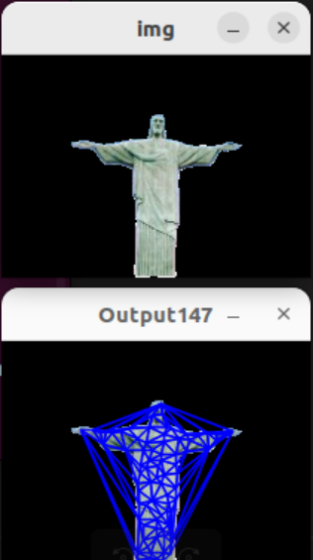
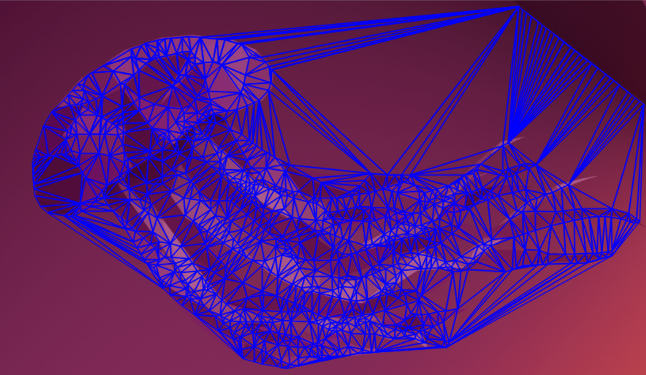
Delaunay Triangulation-Examples
Ubuntu Triangulated

Slide 19
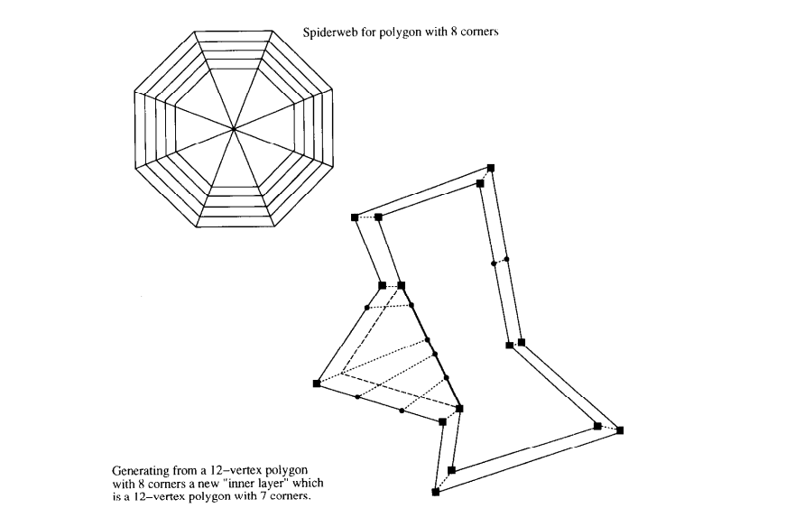
Mapping Algorithm
Finding an optimal method to connect the triangle of the source mesh to the triangle of the target mesh. 2 Methods were tried
> Euclidean Distance on vertices
> Euclidean Distance on Centroid
Source:ACM

Slide 20
Mapping Algorithm-Problems Faced
Initial approach was to traverse in a O(n^2) loop or iteratively choose a source triangle and map to target triangle with least euclidean distance.(Sub Optimal 1st maps to optimal for 2nd case)
Resolution 1, to place the source triangles in a queue map and map to the best fit target. If target is unmapped->map. If it is mapped then see which is more suitable acc. proceed. Too slow
Resolution 2, to precompute the euclidean values and store them in a map structure with key as triangle and value as a min heap having euclidean distance and target triangle. If target is unmapped->map. If it is mapped then see which is more suitable, if existing pair is more suitable, pop the element else, change the mapping and push the formerly connected triangle into queue.

Slide 21
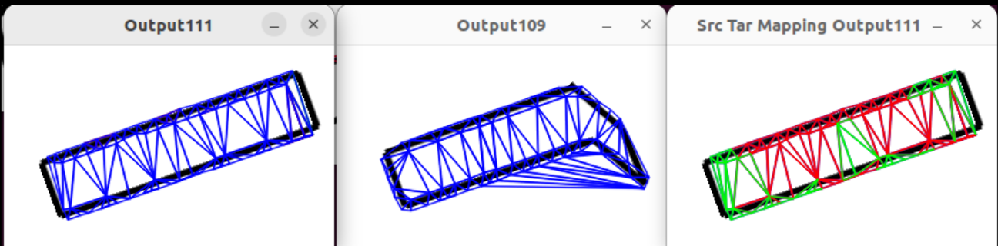
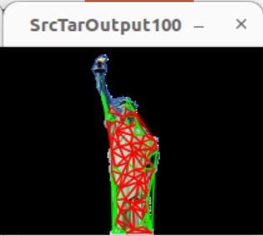
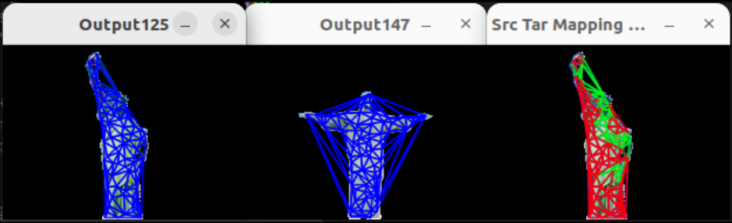
Mapping-Results

Slide 22
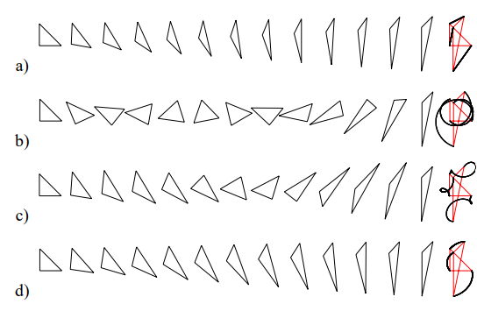
InterPolation-Simple Path Enforcement
This is done by making Singular Value Decomposition and using them to obtain the resultant points
Problem Faced - The Matrix formed is sometimes too large and so the algorithm works slowly, as this is a recursive/step I opted for for doing once per source triangle in the mapping
Method d is a simple path rest aren't

Slide 23
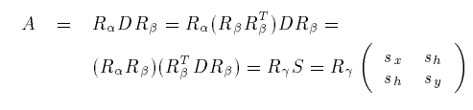
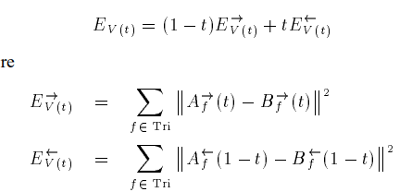
InterPolation-Process & Intermediate State
The algorithm on the previous slide introduced on the last slide is followed iteratives for a number of steps/ till convergence is reached depending on the choice.
After each, step the corresponding state can be displayed.
Problem Faced - on too many iterations the buffer might get full so, its better to send a copy instead
SVD Matrices
Optimal Value Solutions

Slide 24
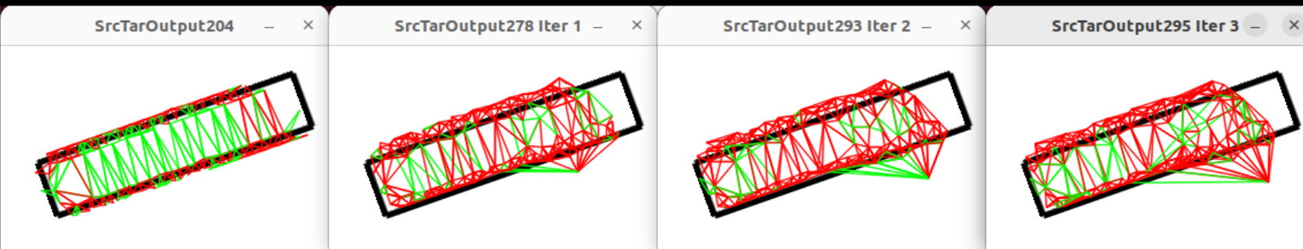
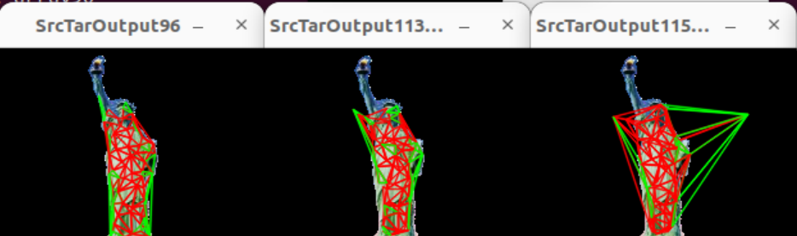
InterPolation-Results

Slide 25
Conclusion,Results and Limitations
> Although the performed mapping is close to correct, the triangulations don’t necessarily find their best fit mesh even after a few iterations of the algorithm
> The algorithm is fast and so, can be used as a baseline for other algorithms
> Some of the Limitations might be due to:
Missing steps in Image Processing
Not combining smaller triangles in delaunay triangulation
Better algorithm for mapping rather than just taking Centroid and
vertices to account
Managing memory efficiently to make use of SVD transformation

Slide 26
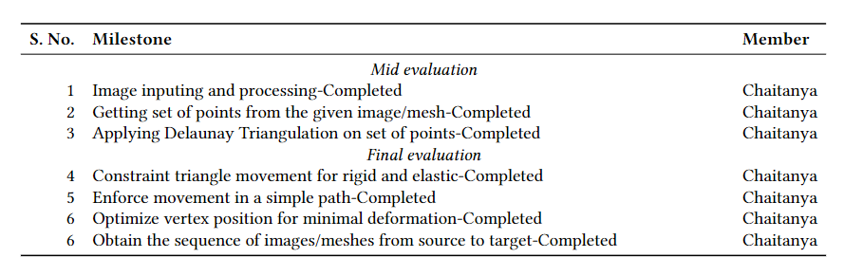
Milestones

Slide 27
References
>https://www.sciencedirect.com/science/article/pii/0925772193900285?via%3Dihub
>https://www.cs.tau.ac.il/~levin/arap.pdf
>https://en.wikipedia.org/wiki/Delaunay_triangulation
>https://dl.acm.org/doi/pdf/10.1145/133994.134001

